Slide 1
SQL Lesson 6a
Where and Order By
V1.0 2020

Slide 2
Lesson Objectives
After completing this lesson you will be able to
Use the WHERE clause to limit the rows you want to display
Sort the output rows using the ORDER BY clause
Use substitution variables to make queries more flexible

Slide 3
Where and order by
Where clause
Order by clause
Substitution variables

Slide 4
Where clause
SELECT * | column1, column2, etc.
FROM table_name
WHERE condition(s);
Restrict the rows returned by a query using WHERE
This optional clause follows the FROM clause
The shorthand shows the location of the WHERE clause

Slide 5
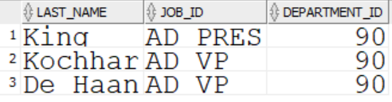
Where clause
Number data
Do not use quotes with number data
SELECT last_name, job_id, department_name
FROM employees
WHERE department_id = 90;

Slide 6
Where clause
Character and date data
Enclose character string and date values in single quotes
Character values are case sensitive and date values are format sensitive
The default date format is DD-MON-RR
DD is the two digit day of the month
MON is the three letter capitalized month abbreviation
RR is the two digit year
Dates are discussed in detail in Lesson 07a Single-Row Functions Part 1

Slide 7

Where clause
Character and date data
Enclose character string values in single quotes
Character data is case sensitive
SELECT last_name, job_id, department_id
FROM employees
WHERE last_name = ‘Whalen’;

Slide 8

Where clause
Character and date data
Enclose date values in single quotes
SELECT last_name, job_id, manager_id, hire_date
FROM employees
WHERE hire_date = ‘10-APR-09’;

Slide 9
Where clause
Comparison operators
Operator | Meaning | Notes
= | Equal to | Can only compare to one value
!= <> ^= | Not equal to
> | Greater than
>= | Greater than or equal to
< | Less than
<= | Less than or equal to
IN | Equal to any value in a set | Easily work with NOT logical operator
BETWEEN … AND | Between two values inclusively
LIKE | Match a character pattern
IS NULL | Has no value

Slide 10
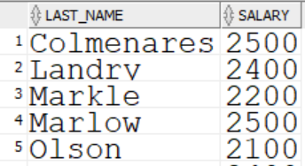
Where clause
Comparison operators
The first six comparison operators compare to one value only
The last four operators work easily with the NOT keyword
SELECT last_name, salary
FROM employees
WHERE salary <= 2500 ; --compares to one value only
…

Slide 11
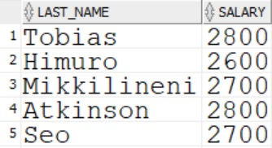
Where clause
Comparison operators
Use BETWEEN … AND … to display rows based on an inclusive range of values
BETWEEN…AND… works with Number, Character, and Date data
SELECT last_name, salary
FROM employees
WHERE salary BETWEEN 2600 AND 2800;
…

Slide 12
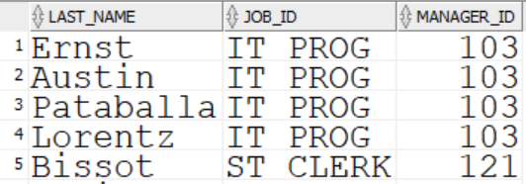
Where clause
Comparison operators
Use IN to find rows based on equality with a set of values
IN is the equivalent of =, but allows multiple values on the right
SELECT last_name, job_id, manager_id
FROM employees
WHERE manager_id IN (103,121,148);
…

Slide 13
Where clause
Comparison operators
Use LIKE to perform wildcard searches through character, number, date, and timestamp data
Search conditions will be in quotes, or ticks, and can contain
Literal values
_ which denotes one character
% which denotes 0 or more characters

Slide 14
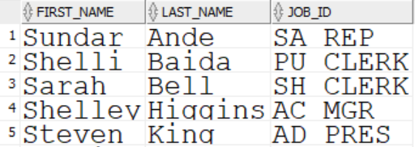
Where clause
Comparison operators
Pattern matching using the LIKE operator
SELECT first_name, last_name, job_id
FROM employees
WHERE first_name LIKE ‘S%’;
…

Slide 15
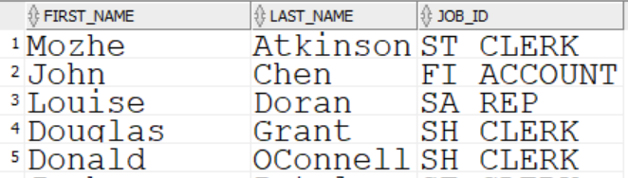
Where clause
Comparison operators
Pattern matching using the LIKE operator
SELECT first_name, last_name, job_id
FROM employees
WHERE first_name LIKE ‘_o%’;
…

Slide 16

Where clause
Comparison operators
Check for nulls with the IS NULL operator
SELECT first_name, job_id, department_id
FROM employees
WHERE department_id IS NULL;

Slide 17
Where clause
Logical Operators
Operator | Meaning
AND | Returns true if both conditions are true
OR | Returns true if either condition is true
NOT | Returns true if the condition is false

Slide 18
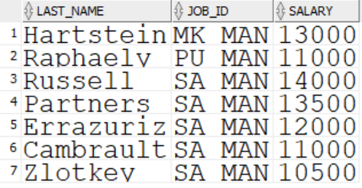
Where clause
Logical operators
AND requires both conditions to be true
SELECT first_name, last_name, salary
FROM employees
WHERE salary >= 10000
AND job_id LIKE ‘%MAN’;

Slide 19
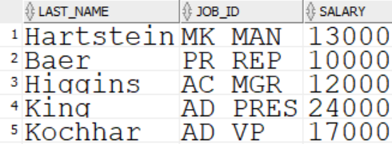

Where clause
Logical operators
OR requires either condition to be true
SELECT first_name, last_name, salary
FROM employees
WHERE salary >= 10000
OR job_id LIKE ‘%MAN’;
…

Slide 20
Where clause
Logical operators
NOT turns true into false, and false into true
Operator | Becomes
IN | NOT IN
LIKE | NOT LIKE
BETWEEN…AND | NOT BETWEEN …AND
IS NULL | IS NOT NULL

Slide 21
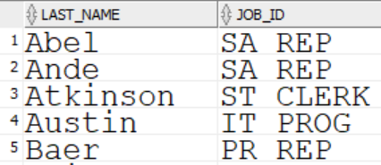
Where clause
Logical operators
NOT logical operator
SELECT last_name, job_id
FROM employees
WHERE job_id NOT IN (‘AD_PRES’, ‘AD_VP’,‘SA_MAN’);
…

Slide 22
Where clause
Logical operators priority
The priority of the three logical operators is:
Operator | Priority
NOT | 1
AND | 2
OR | 3

Slide 23
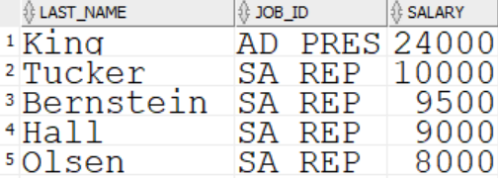
Where clause
Logical operators
Conditions surrounding AND are evaluated before OR
SELECT first_name, last_name, salary
FROM employees
WHERE job_id = ‘SA_REP’
OR job_id = ‘AD_PRES’ AND salary > 15000;
…

Slide 24

Where clause
Logical operators
Parentheses will override the default priority
SELECT first_name, last_name, salary
FROM employees
WHERE (job_id = ‘SA_REP’ OR job_id = ‘AD_PRES’)
AND salary > 15000;

Slide 25
Where and order by
Where clause
Order by clause
Substitution variables

Slide 26
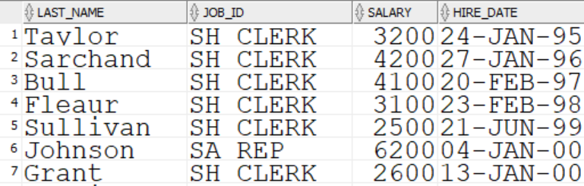
Order by clause
Sort the retrieved data using the ORDER BY clause.
ORDER BY is the last clause in the basic SELECT statement.
ASC - ascending order is the default.
DESC – descending order can be specified
SELECT last_name, job_id, salary, hire_date
FROM employees
ORDER BY hire_date;
…

Slide 27
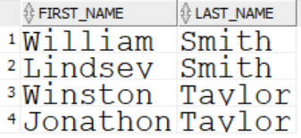
Order by clause
Sort in descending order with DESC
SELECT first_name, last_name
FROM employees
WHERE last_name IN (‘Smith’ , ‘Taylor’)
ORDER BY last_name, first_name DESC;

Slide 28
Where and order by
Where clause
Order by
Substitution variables

Slide 29
Substitution variables
Substitution Variables allow statements to run more dynamically
Queries can be saved and reused with minor changes at run-time
The user is prompted to enter a value to be used for the current execution of the statement
Single ampersand & and double ampersand && substitution can occur anywhere in a statement

Slide 30
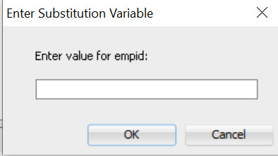
Substitution variables
Use a variable name prefixed with & to prompt the user
SELECT first_name, last_name, salary, job_id
FROM employees
WHERE employee_id = &empid;

Slide 31
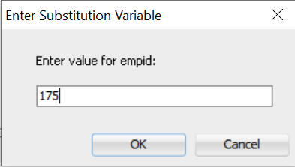

Substitution variables
The value is used and then discarded from session memory
SELECT first_name, last_name, salary, job_id
FROM employees
WHERE employee_id = &empid;

Slide 32
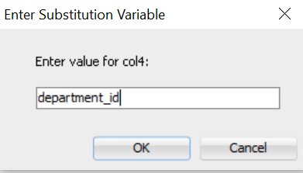
Substitution variables
Use a variable name prefixed with && to prompt the user only once
SELECT first_name, last_name, salary, &&col4
FROM employees
ORDER BY &col4;

Slide 33
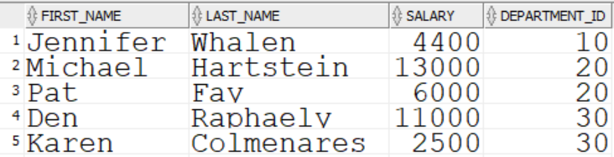

Substitution variables
The value provided is used and kept in session memory
…

Slide 34
Substitution variables
We will see in Lesson 6b Where and Order By.sql how to remove the entered value from your session memory

Slide 35
Quiz
True or false?
The WHERE clause allows you to choose which columns to display
The ORDER BY clause specifies the order of the rows displayed
Always put quotation marks around number data
By default, ORDER BY sorts the result in descending order
Substitution variables allow statements to be completed at run time

Slide 36
Review
In this lesson you learned how to
Use the WHERE clause to limit the rows you want to display
Sort the output rows using the ORDER BY clause
Use substitution variables to make queries more flexible

Slide 37
Questions?

